Slide 1


Modern Block Ciphers- DES & AES
Ms. Swati Mali
swatimali@somaiya.edu
Somaiya Vidyavihar University

Slide 2
Module 3: Symmetric Key Cryptography
3.1 | Building blocks of modern and classical Block Ciphers: P box, S Box, EX-OR operations, circular shifts, swaps, split and combine, Rounds, Initialization vectors, Confusion, Diffusion, Fiestel Ciphers, Non-Fiestel ciphers
3.2 | Introduction to classical block ciphers as means of confusion and diffusion techniques : Initialization vector, Electronic code book[ECB], Cipher feedback[CFB], cipher block chaining[CBC], output feedback[OFB], propagating cipher block chaining[PCBC], counter[CTR]
3.3 | DES: DES Structure, DES Analysis: Properties, Design Criteria, DES Strength and Weaknesses, DES Security, Multiple DES, 3DES, AES vs DES

Slide 3
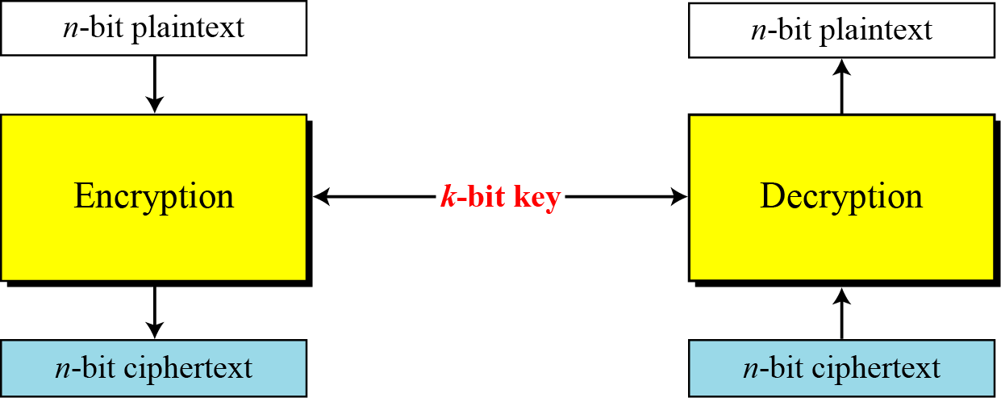
MODERN BLOCK CIPHERS
A symmetric-key modern block cipher :
  encrypts an n-bit block of plaintext or
  decrypts an n-bit block of ciphertext.
  The encryption or decryption algorithm uses a k-bit key.

Slide 4
“must-know” vocabulary terms
Avalanche Effect - Small change in input causes large change in output (important in ciphers & hashes)
Initialization Vector (IV) – Random/non-repeating input ensuring same plaintext doesn’t give same ciphertext.
Padding – Adding extra data to fit block size.
Rounds – Repeated transformations in encryption (e.g., multiple rounds in AES, DES).

Slide 5
3.2 Classical block ciphers
Electronic codebook mode
Cipher feedback mode
Output feedback mode
Cipher block chaining with checksum

Slide 6
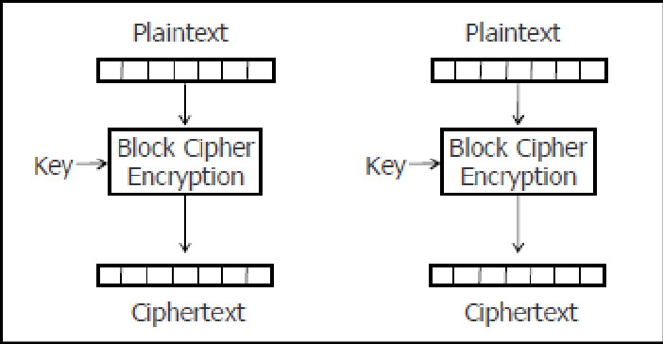
Electronic codebook mode

Slide 7
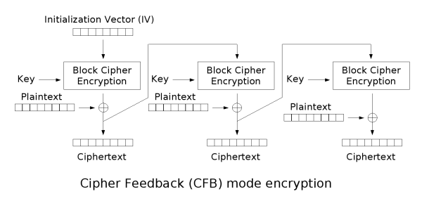
Cipher Feedback Mode

Slide 8
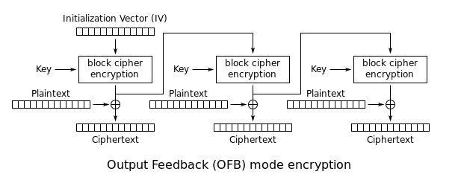
Output Feedback Mode

Slide 9
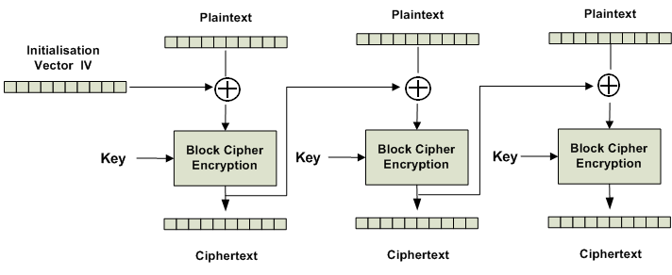
Cipher block chaining mode

Slide 10
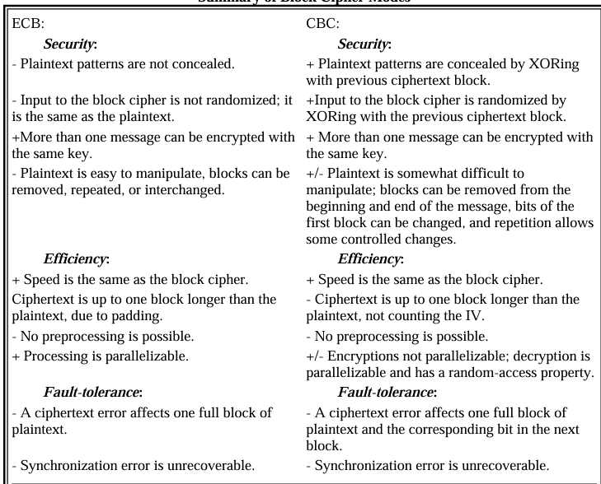
Summary : Classical block cipher modes

Slide 11
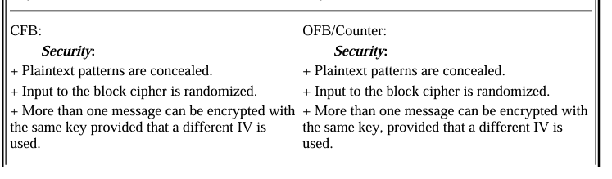
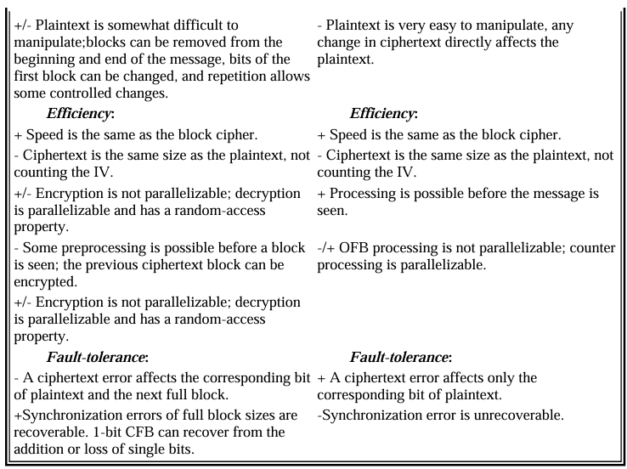

Slide 12
Reference: Bruce Schneier, “Applied Cryptography”, 2nd Edition

Slide 13
Modern Block Cipher techniques

Slide 14
Modern Block Cipher techniques
Confusion – substitution – S Box
Diffusion – transposition – P Box
Ex-OR operations
Circular Shift
Swap
Split and combine
Product cipher - complex cipher combining substitution, permutation, and other components (introduced by Shannon)
rounds

Slide 15
Diffusion
The idea of diffusion is to hide the relationship between the ciphertext and the plaintext.
Frustrate the adversary who uses ciphertext statistics to find plaintext
If a single symbol in plaintext is changes, several or all symbols in the ciphertext will also be changed
Diffusion hides the relationship between the ciphertext and the plaintext.

Slide 16
Confusion
The idea of confusion is to hide the relationship between the ciphertext and the key.
Frustate the adversary who uses ciphertext statistics to find key
If a single bit in the key is changed, most or all bits in the ciphertext will also be changed
Confusion hides the relationship between the ciphertext and the key.

Slide 17
S-Box
An S-box (substitution box) can be thought of as a miniature substitution cipher
S Box can be keyed or keyless
Modern Block ciphers normally use keyless S Box where the mapping from inputs to outputs is predetermined
An S-box is an m × n substitution unit, where m and n are not necessarily the same.

Slide 18
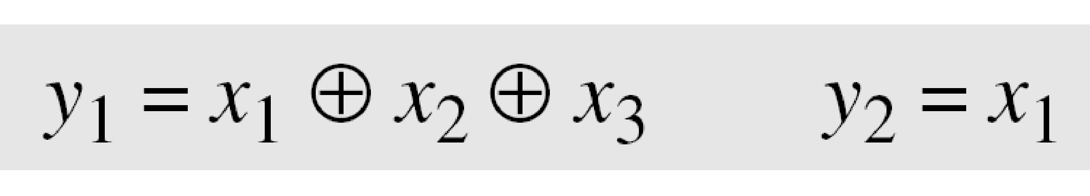
S-Box
S Box are substitution ciphers in which relationship between input and output is defined by
  a table or
  mathematical relation
    E.g
If the input is 110 then the output y1= 0 and y2= 1
If the input is 001 then the output y1= 1 and y2= 0.

Slide 19
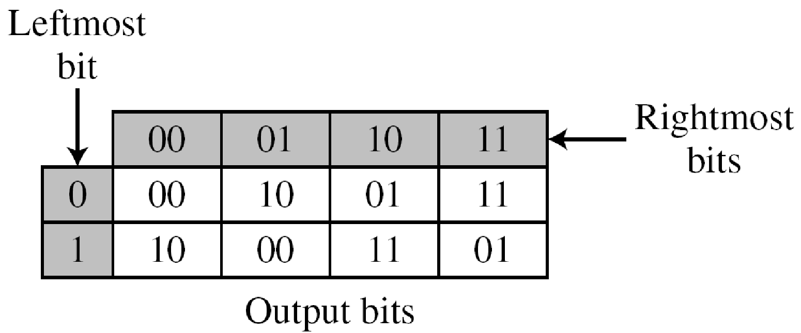
S-Box
Tabular s box example (non-invertible)
For i/p = 001, o/p = 10
First 1 bit makes row, rest two bits make column

Slide 20
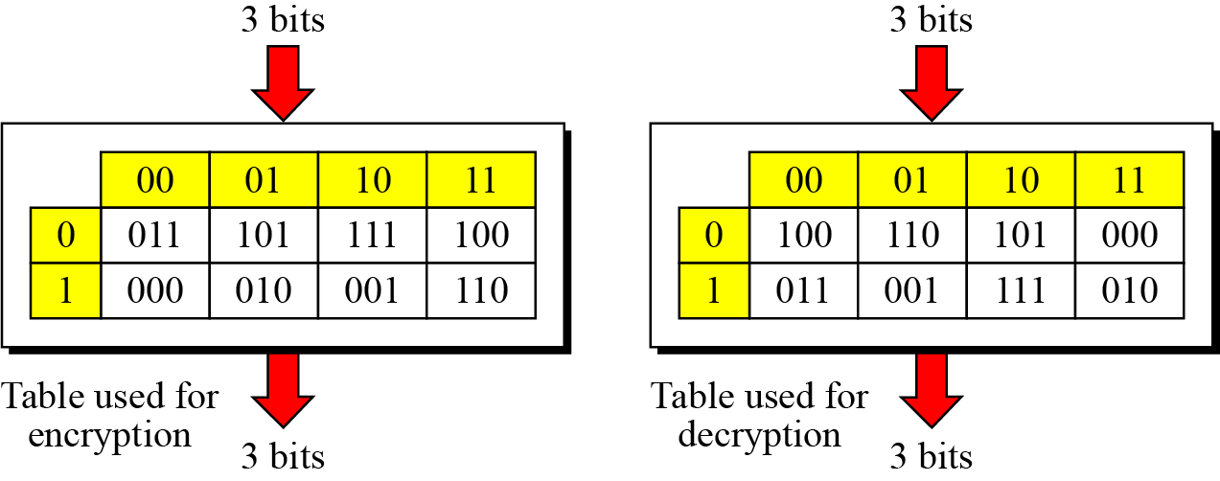
Invertability of S-Box
An S-box may or may not be invertible.
In an invertible S-box, the number of input bits should be the same as the number of output bits
Example : invertible S box
Notes:
if the input to the left box is 001, the output is 101.
The input 101 in the right table creates the output 001, which shows that the two tables are inverses of each other.

Slide 21
P-Box
Permutation Box parallels the traditional transposition cipher for characters
It transposes bits
Types
    Straight P box
    Compression P box
    Expansion P box

Slide 22
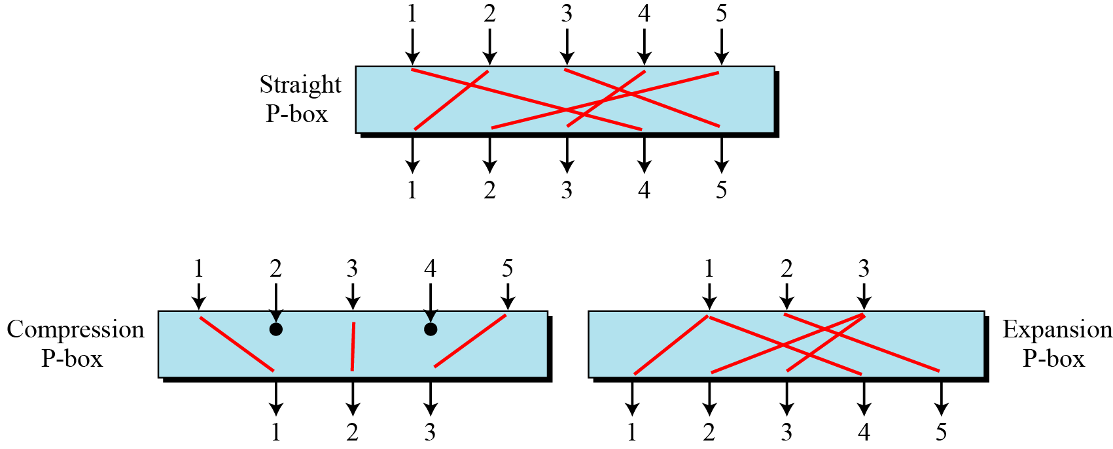
Types of P Boxes

Slide 23
Straight P box
A straight P-box is a P-box with n inputs and n outputs
n! possible mappings
P Box is normally Keyless
Mapping is predetermined
If implemented in Hardware, then Prewired
IF implemented in software, Permutation table shows rule of mapping

Slide 24
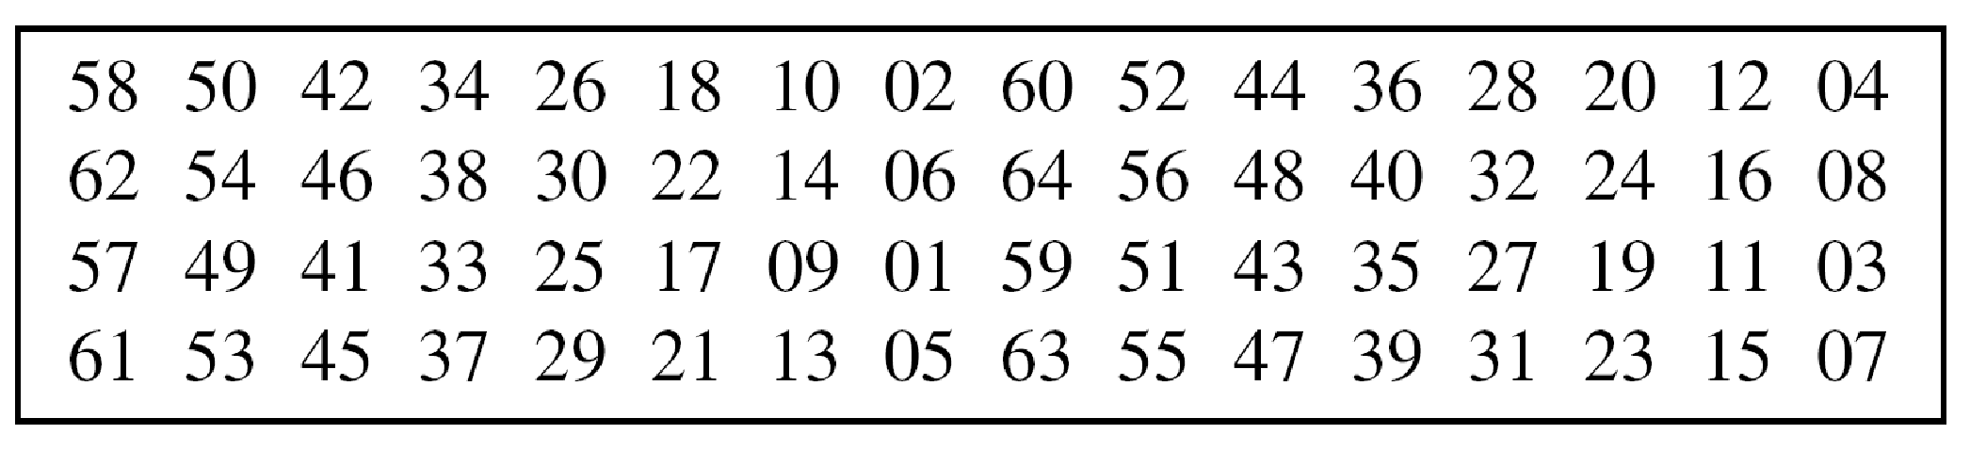
Straight P-Boxes
64 Inputs
64 Outputs
The index of the entry corresponds with the output
First entry is 58=>First Output comes from 58th Input
Last Entry is 07=>64th Output comes from 7th Input

Slide 25
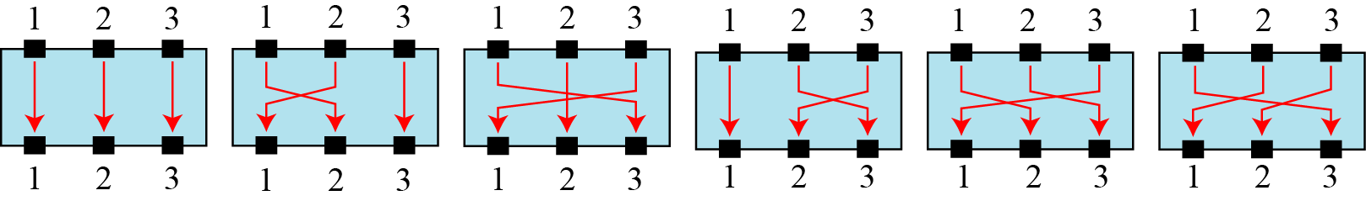
All possibilities of a 3 × 3 straight P-box.

Slide 26
Example
Design an 8 × 8 permutation table for a straight P-box that moves the two middle bits (bits 4 and 5) in the input word to the two ends (bits 1 and 8) in the output words. Relative positions of other bits should not be changed.
Solution
We need a straight P-box with the table [4 1 2 3 6 7 8 5]. The relative positions of input bits 1, 2, 3, 6, 7, and 8 have not been changed, but the first output takes the fourth input and the eighth output takes the fifth input.

Slide 27
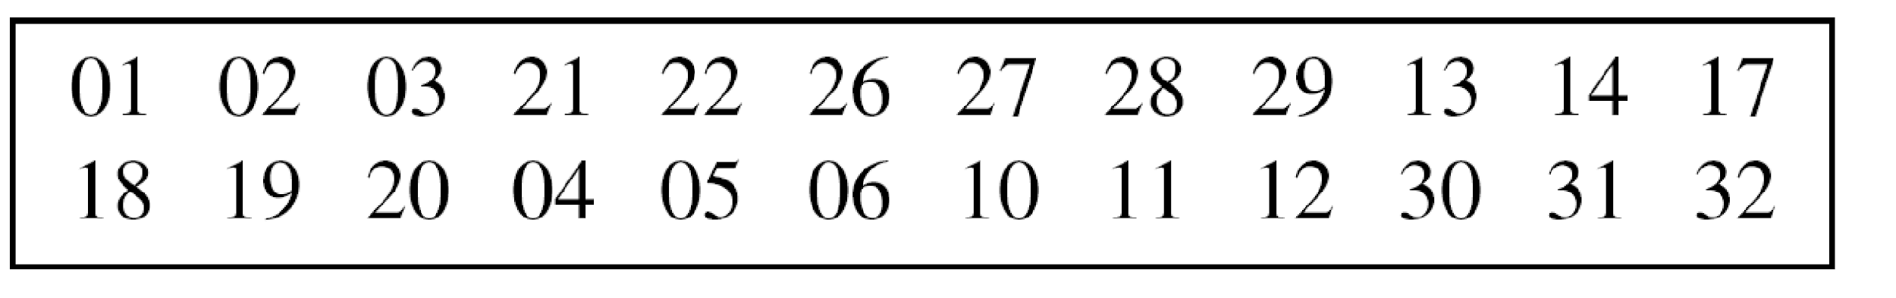
Compression P Box
A compression P-box is a P-box with n inputs and m outputs where m < n.
Some of the inputs are blocked and do not reach the output.
Inputs 7,8,9,15,16,23,24 and 25 are blocked
Used when we need to permute bits and the same time decrease the number of bits for next stage
Example of a 32 × 24 permutation table

Slide 28
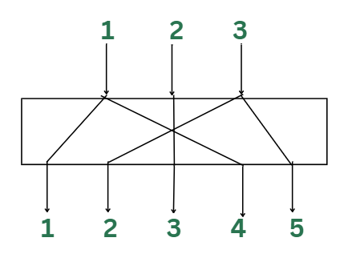
Expansion P-box
An expansion P-box is a P-box with n inputs and m outputs where m > n.
Some of the inputs are connected to more than one output

Slide 29
Invertability of P Box
A straight P-box is invertible,
but compression and expansion P-boxes are not.
A straight P-box is invertible=>We can use Straight box in the encryption cipher and its inverse in the decryption cipher
Permutation tables need to be inverses of each other

Slide 30
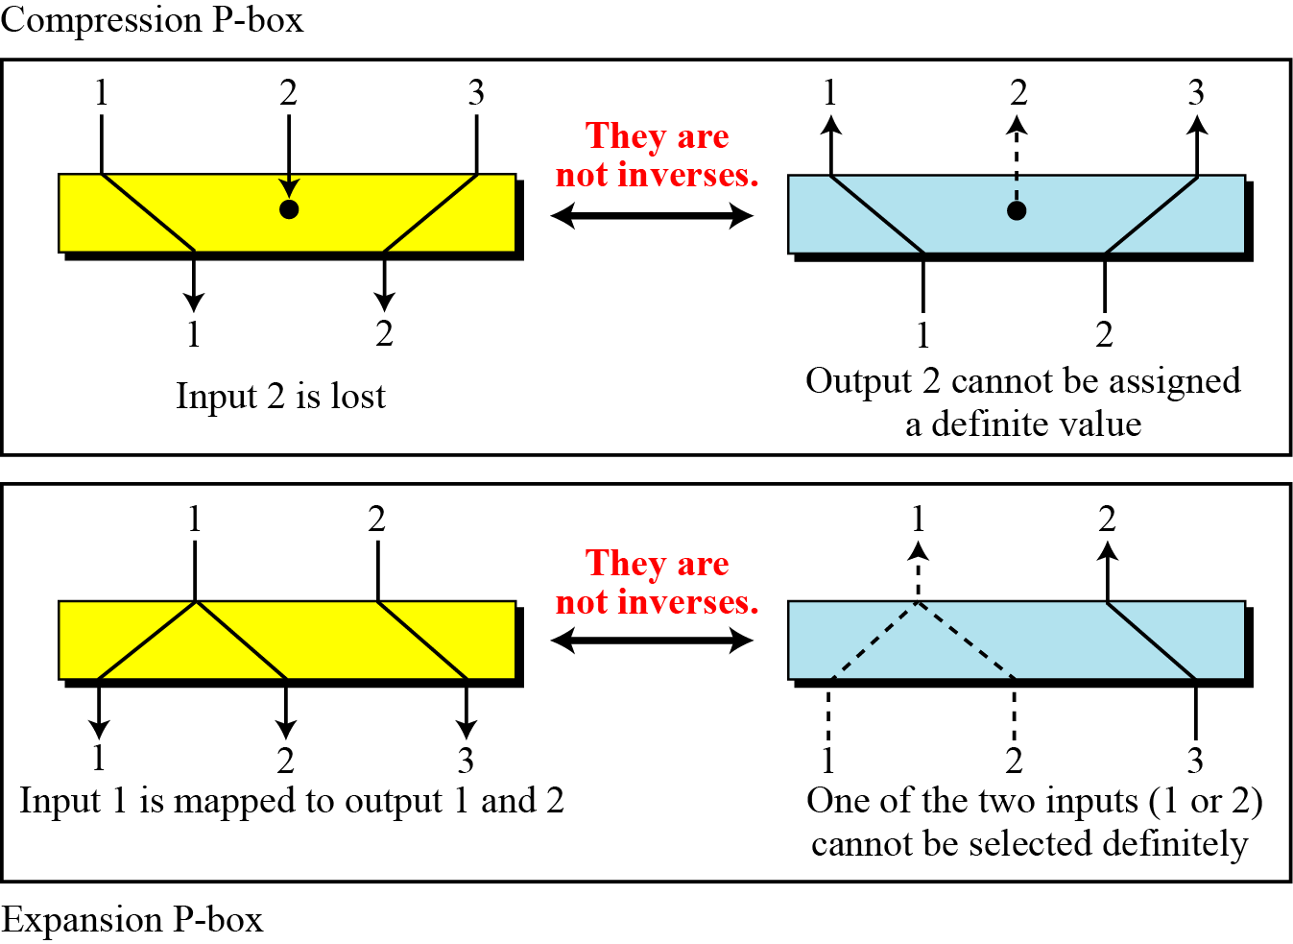
Invertability of P Box
In Compression P Box-
An input can be dropped During Encryption .
The Decryption Algorithm doesn’t have a clue how to replace the dropped bit.

Slide 31
Invertability of P Box
In Expansion P Box-
An input may be mapped to more than one output during Encryption. The Decryption algorithm does not have a clue which of the several inputs are mapped to an output.

Slide 32
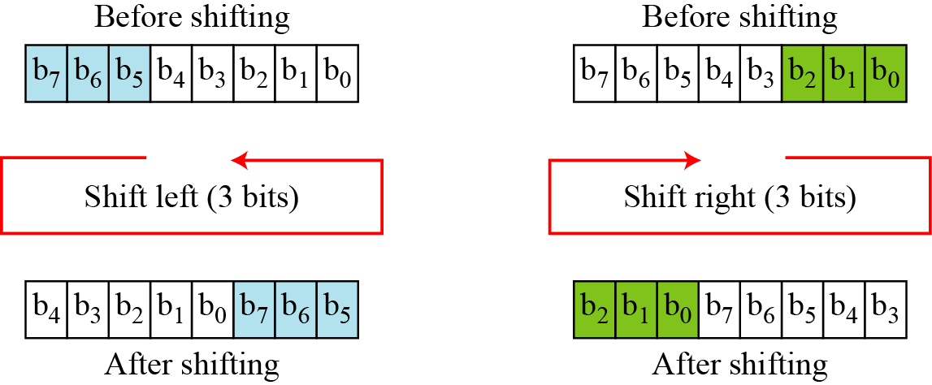
Circular Shift
Mixes bits in a word and helps hide the patterns in the original word
Circular left shift operation shifts each bit in a n bit word, k positions left.
The leftmost k bits are removed from the left and become the rightmost bits

Slide 33
Circular right shift operation shifts each bit in a n bit word ,k positions right.
The rightmost k bits are removed from the right and become the leftmost bits

Slide 34
Invertibility of circular shift
Invertibility- A circular left shift operation is the inverse of the circular right shift operation
If one is used in encryption cipher, The other can be used in the Decryption cipher

Slide 35
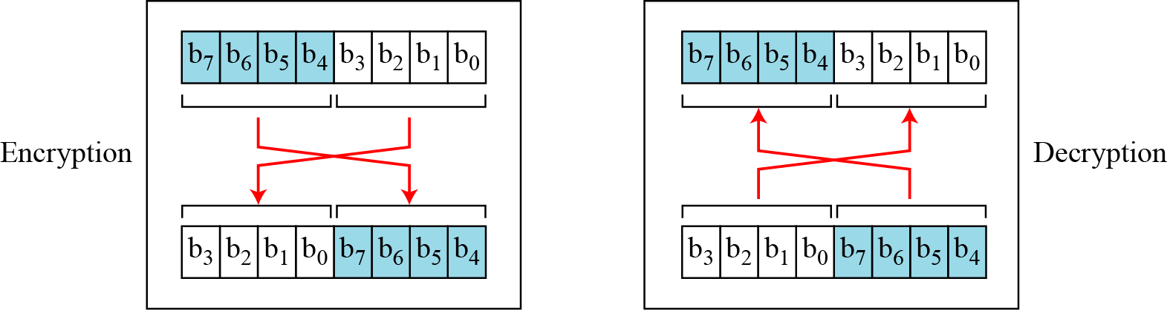
Swap
The swap operation is a special case of the circular shift operation where k = n/2.
Swap operation on an 8-bit word

Slide 36
Swap operation invertability
Self Invertible-A swap operation in Encryption cipher can be totally cancelled by a swap operation in the decryption cipher

Slide 37
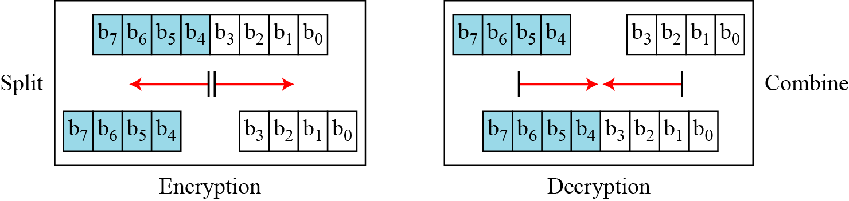
Split and Combine
Two other operations found in some block ciphers are split and combine.
Split and combine operations on an 8-bit word

Slide 38
Split and Combine
Split operation splits an n-bit word in the middle creating two equal length words
Combine operation normally concatenates two equal length words to create an n bit word.
Inverse of each other
Used as a pair to cancel each other out.
Split and combine operations on an 8-bit word

Slide 39
Rounds
Diffusion and confusion can be achieved using iterated product ciphers where each iteration is a combination of S-boxes, P-boxes, and other components.
The block cipher uses a Key schedule or Key generator that creates different keys for each round.
In a N-round cipher, the plaintext is encrypted N times to create the ciphertext.
The ciphertext is decrypted N times to create the plaintext

Slide 40
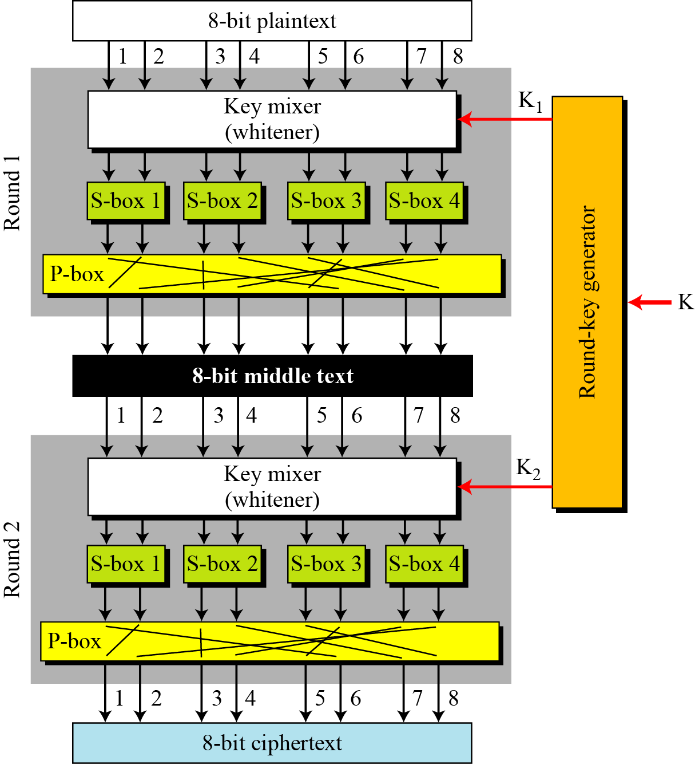
A product cipher with two rounds

Slide 41
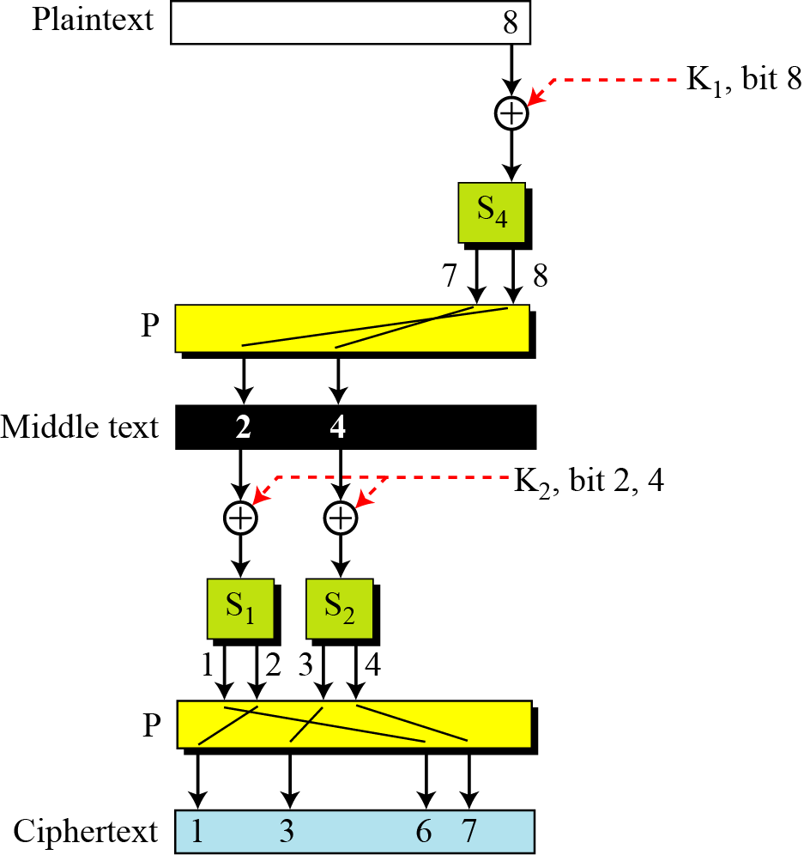
How Changing a single bit in the plain text affects many bits in the ciphertext

Slide 42
Classes of Product Ciphers
Modern block ciphers are all product ciphers, but they are divided into two classes.
Feistel ciphers
  Uses both invertible and non-invertible components
  A Feistel cipher can have three types of components:
  self-invertible, invertible, and noninvertible.
2. Non-Feistel ciphers
  Non-Feistel ciphers-Uses only invertible components
  A non-Feistel cipher uses only invertible components.
  A component in the encryption cipher has the corresponding component in the decryption cipher.

Slide 43
Data Encryption Standard

Slide 44
History of DES
In 1973, NIST published a request for proposals for a national symmetric-key cryptosystem.
A proposal from IBM, a modification of a project called Lucifer, was accepted as DES.
DES was published in the Federal Register in March 1975 as a draft of the Federal Information Processing Standard (FIPS).
Finally published as FIPS 46 in the Federal Register in January 1977
A new standard FIPS 46-3 recommended the use of Triple DES- repeated DES cipher three times
AES, The recent standard is supposed to replace DES in the long run

Slide 45
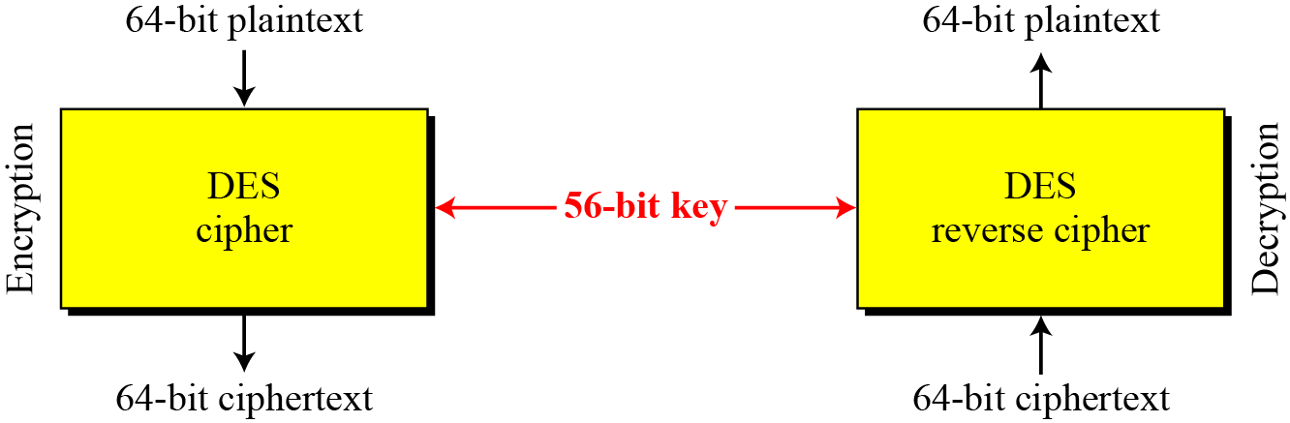
DES - a block cipher
Encryption and decryption with DES

Slide 46
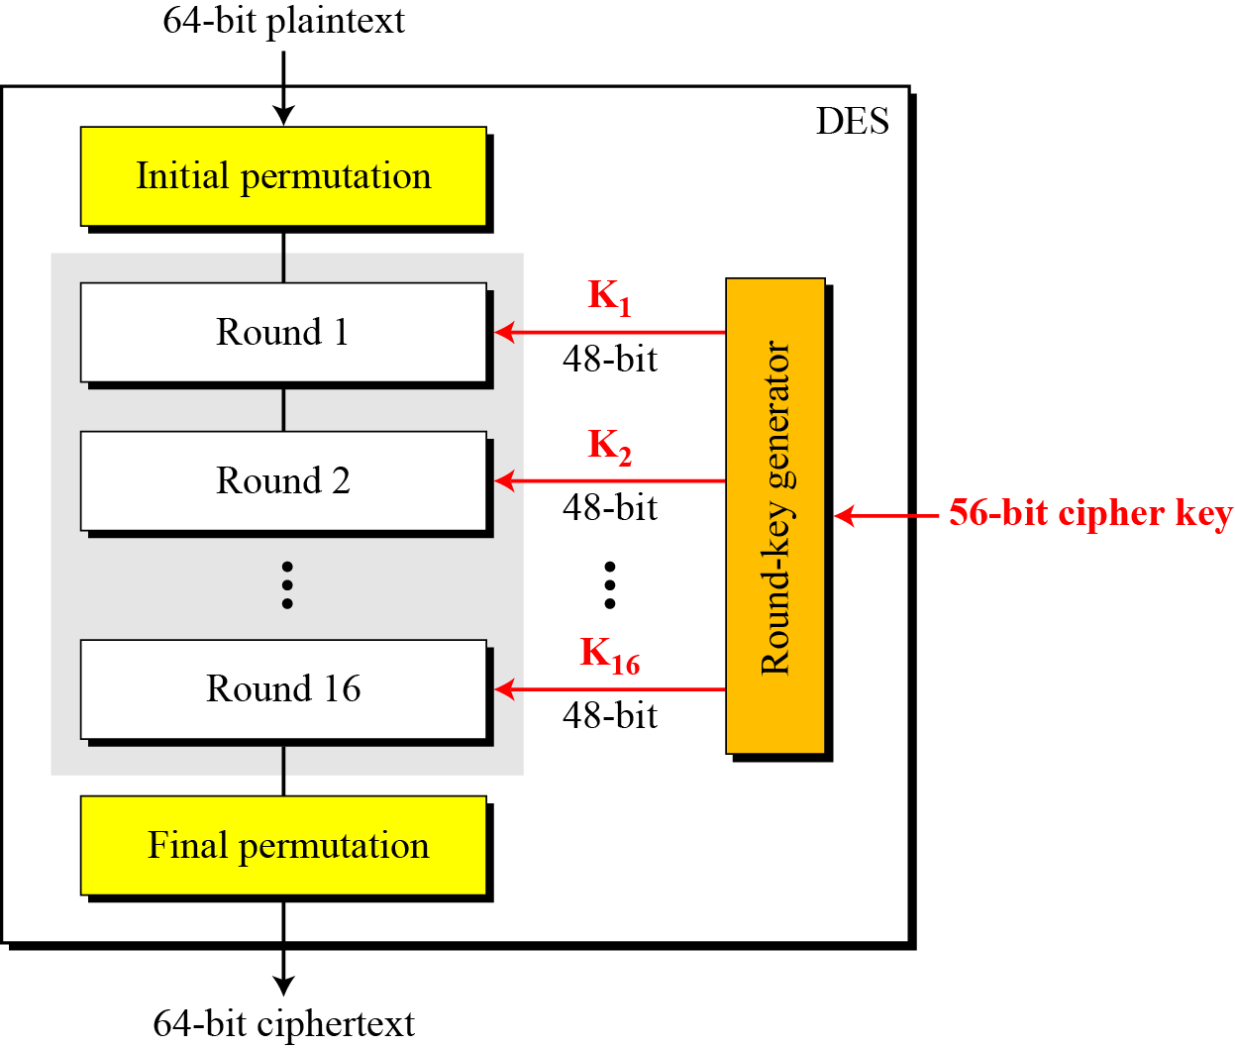
DES Structure
The encryption process is made of two permutations (P-boxes), which we call initial and final permutations, and sixteen Feistel rounds.

Slide 47
DES Keys and General structure
Each round uses a different 48 bit round key generated from the cipher key according to a predefined algorithm
Fig: General structure of DES

Slide 48
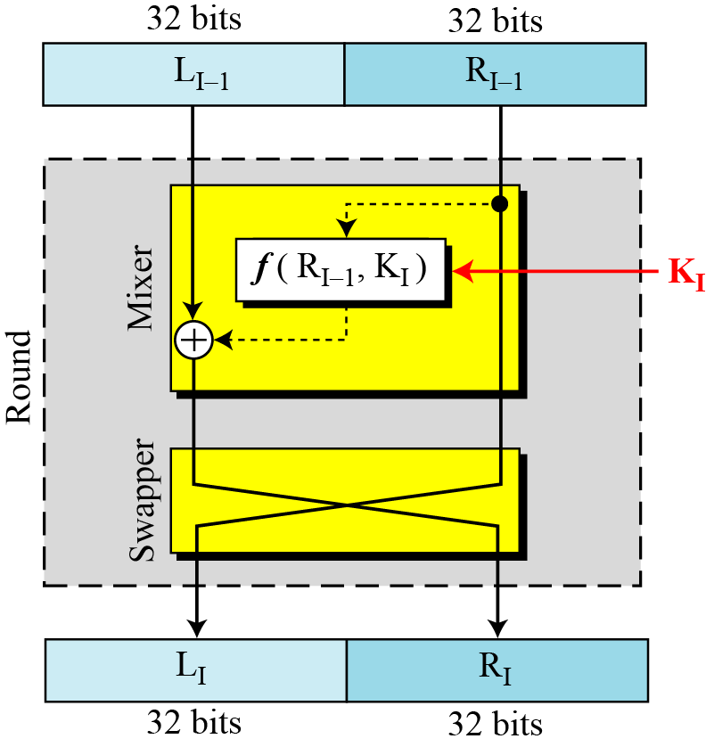
DES Rounds
Swapper is invertible
Mixer is invertible because of EXOR operation
All non invertible elements are collected inside the function f

Slide 49
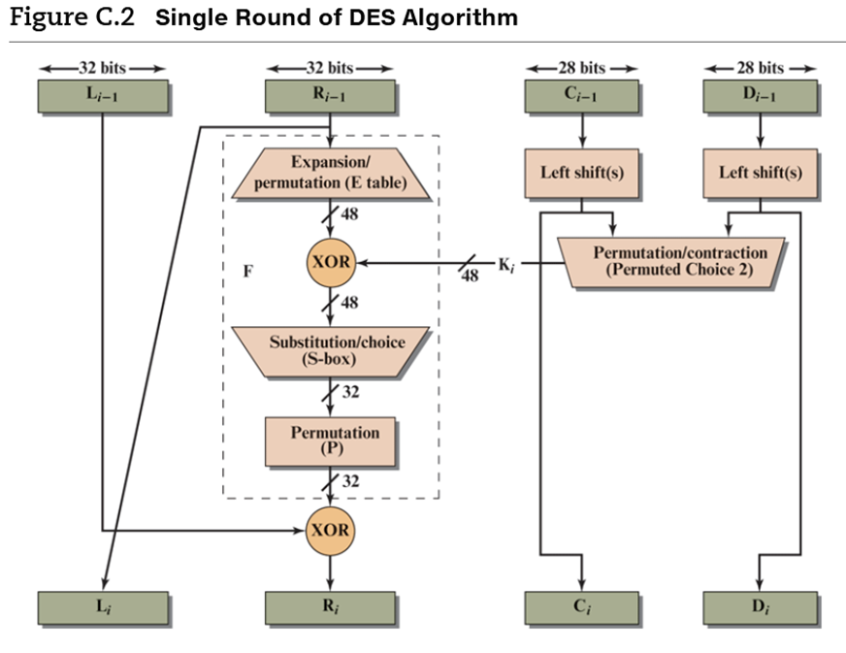
A round in DES
The DES function applies a 48-bit key to the rightmost 32 bits to produce a 32-bit output.

Slide 50
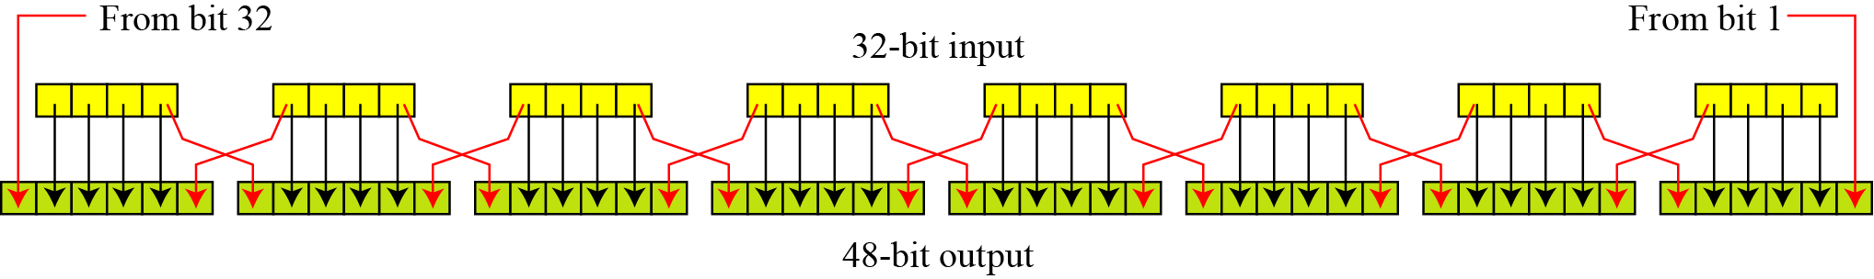
Expansion P-box
Since R_{I−1} is a 32-bit input and K_{I} is a 48-bit key, we first need to expand R_{I−1} to 48 bits.
Figure 6.6 Expansion permutation

Slide 51
Expansion P-box
For each section, I/P bits 1,2,3 and 4 are copied to O/P bits 2,3,4 and 5 respectively.
Output Bit 1 comes from bit 4 of previous section
Output bit 6 comes from bit 4 of next section
Sections 1 and 8 are considered adjacent, Same rule applies to bits 1 and 32
Expansion permutation

Slide 52
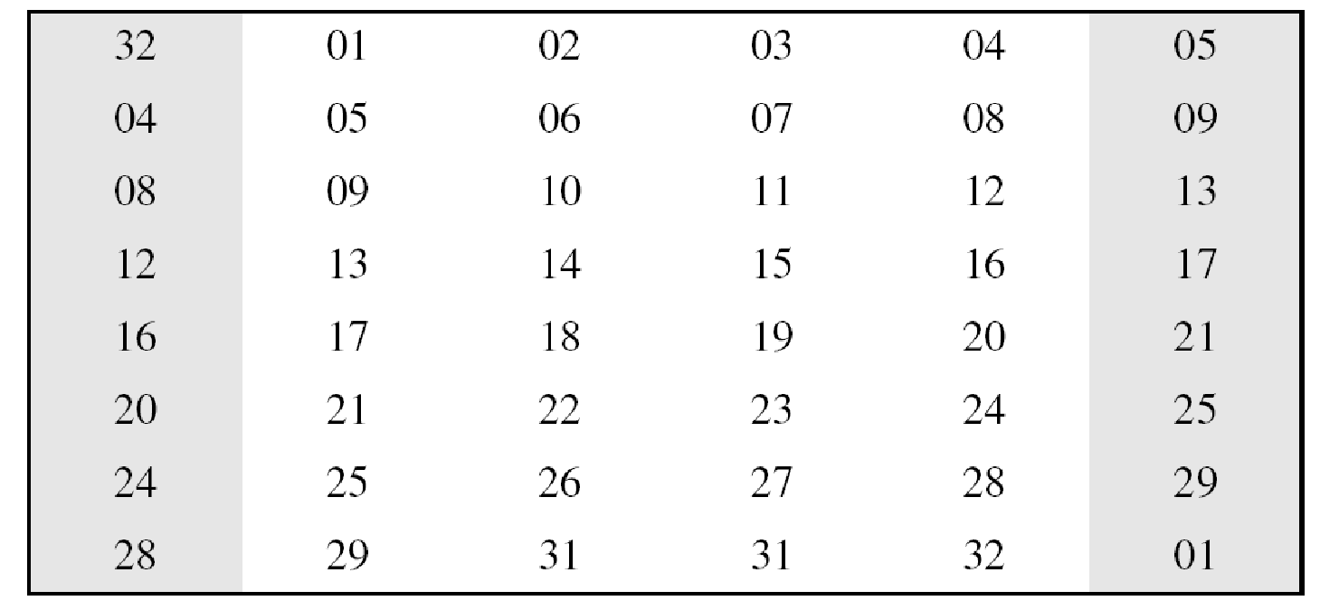
Expansion P-box expressed as table
Although the relationship between the input and output can be defined mathematically, DES uses Table to define this P-box.
A 6 X 8 Table
Expansion P-box table

Slide 53
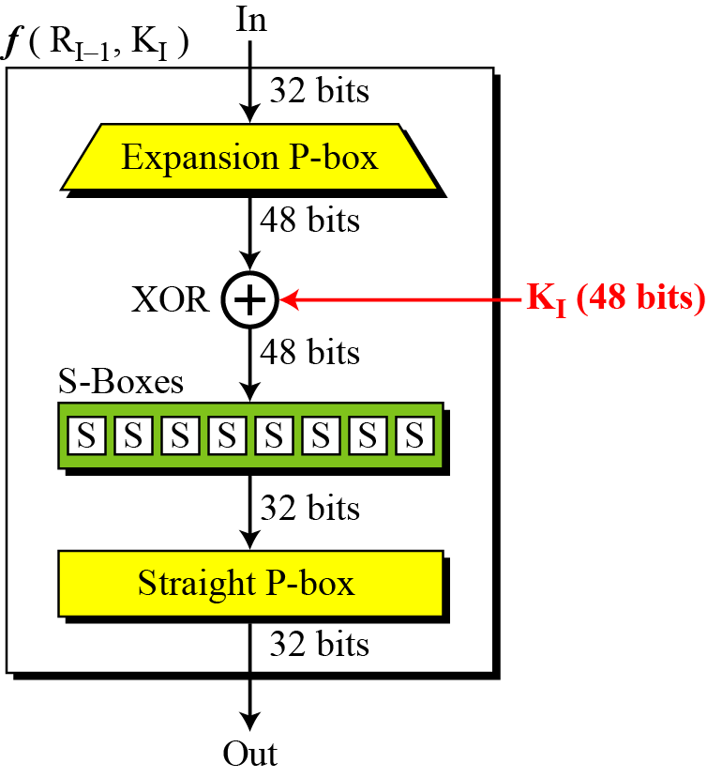
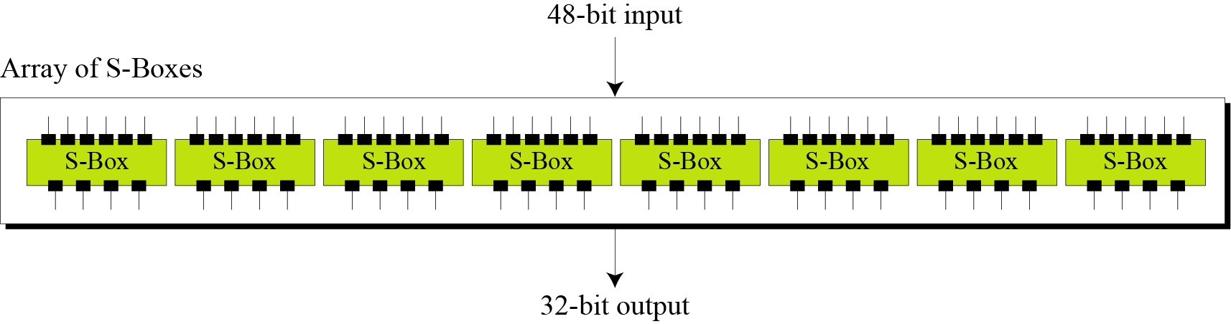
S-Boxes
The S-boxes do the real mixing (confusion).
48 bit output from Whitener is divided into Eight 6-bit chunks
DES uses 8 S-boxes,
Each 6-bit chunk as input and a 4-bit output.
S-boxes

Slide 54
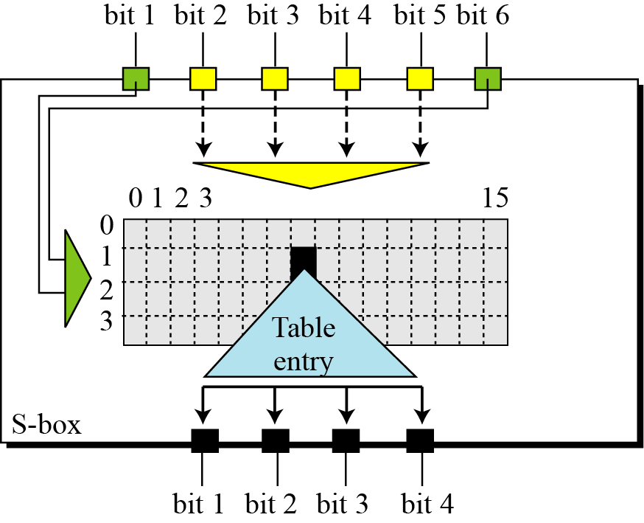
S-box rule: Bit 1 and 6 make the row, bits 2 to 5 make the column

Slide 55
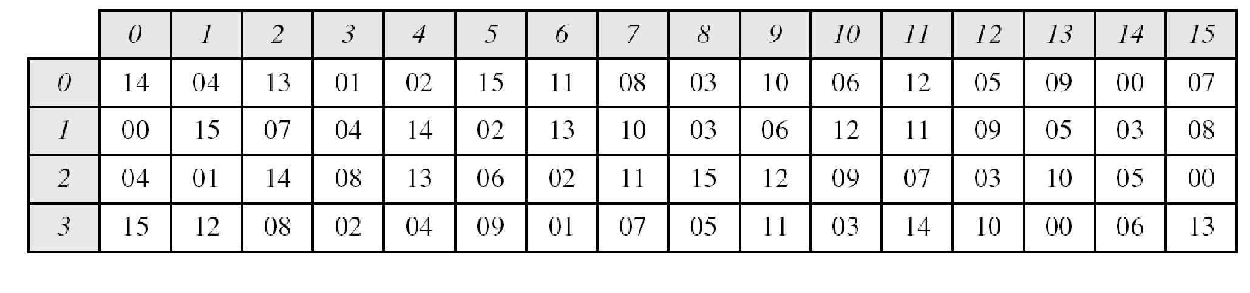
Example
Table 6.3 shows the permutation for S-box 1.
For the rest of the boxes see the textbook.
The row number and column no, output are given as decimal to save space
These need to be changed to binary
Table 6.3 S-box 1

Slide 56
Example
The input to S-box 1 is 100011. What is the output?
Solution
If we write the first and the sixth bits together, we get 11 in binary, which is 3 in decimal.
The remaining bits are 0001 in binary, which is 1 in decimal.
We look for the value in row 3, column 1, in Table (S-box 1).
The result is 12 in decimal, which in binary is 1100. So the input 100011 yields the output 1100.

Slide 57
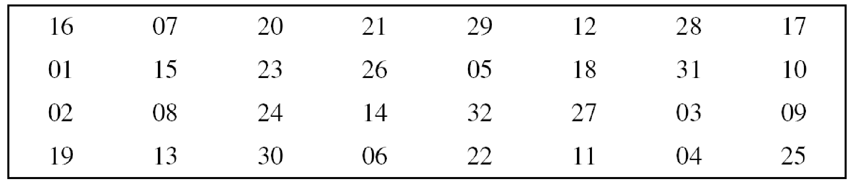
Straight Permutation
Last operation in DES round
Permutation with 32 bit input and 32 bit output
Table 6.11 Straight permutation table

Slide 58
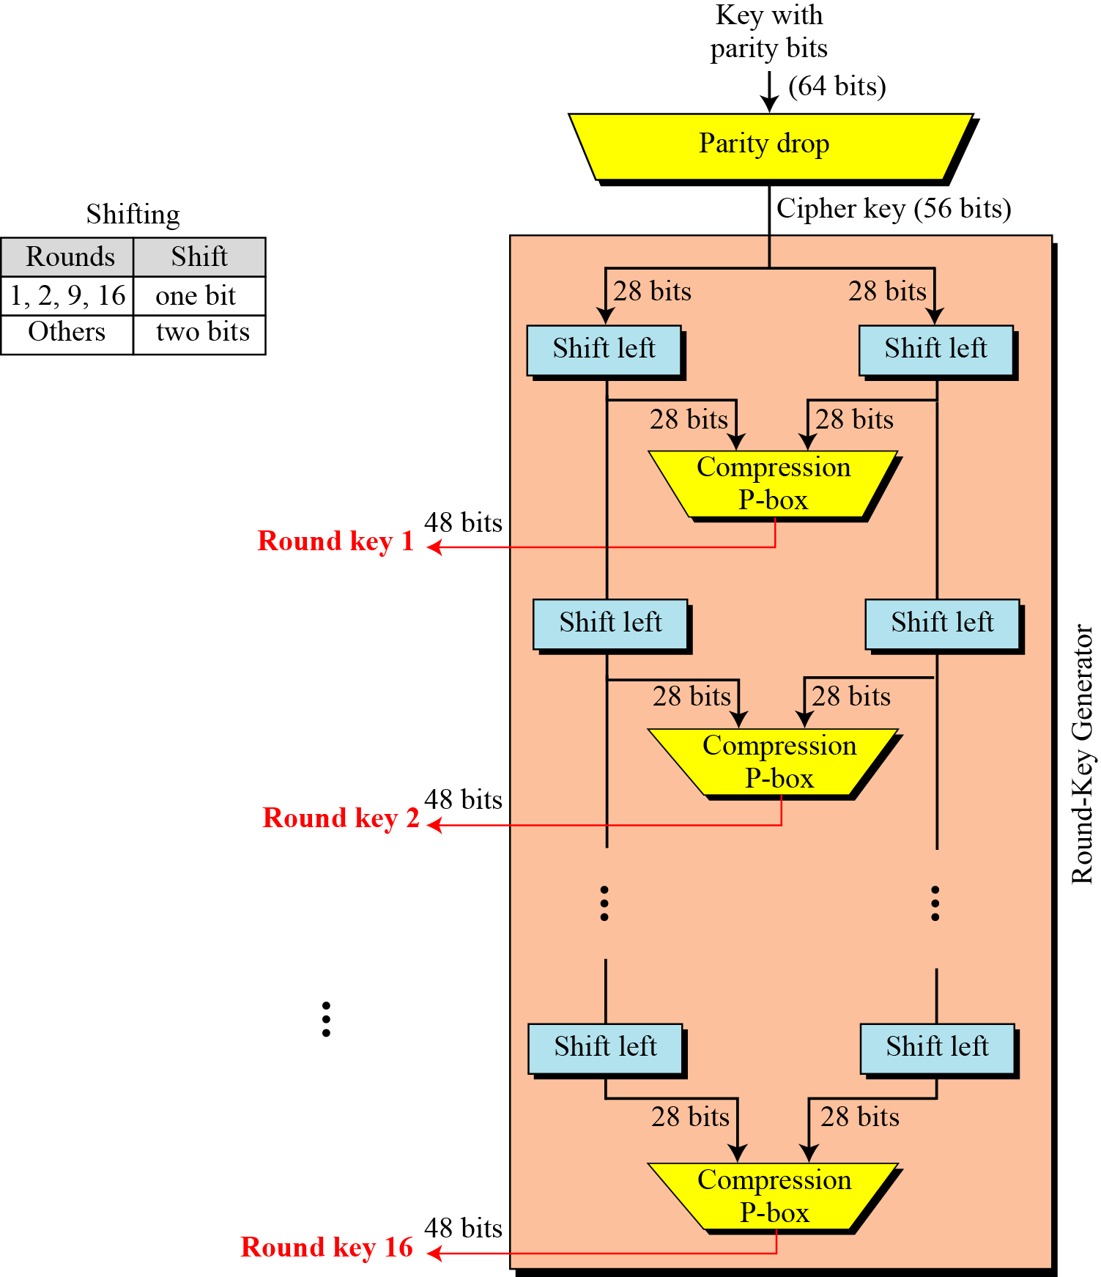
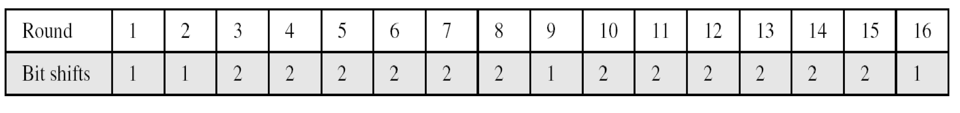
Key Generation
The round-key generator creates sixteen 48-bit keys out of a 56-bit cipher key.
Cipher key is normally given as a 64bit key in which 8 extra bits are parity bits,
which are dropped off before the actual key generation process.

Slide 59
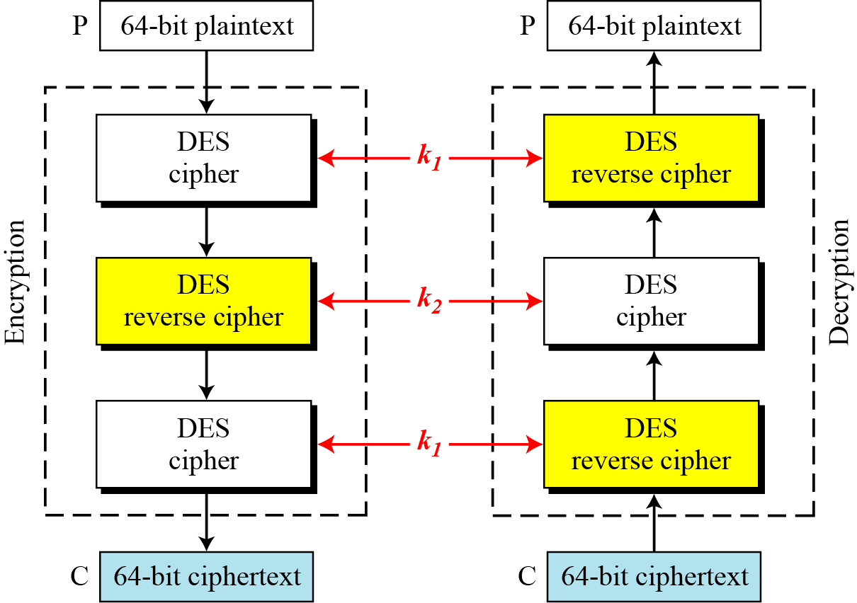
Triple DES
Triple DES with two keys

Slide 60
DES Analysis
Properties
  Avalanche effect
  completeness
Design Criteria
DES Weaknesses

Slide 61
DES Properties
Avalanche effect
A small change in the Plain text ( or key) should create a significant change in the ciphertext
DES has been proved to be strong with respect to this property
Completeness effect
Completeness effect means that each bit of the ciphertext needs to depend on many bits on the plaintext.
Diffusion and Confusion produced by P Boxes and S Boxes in DES show a very strong completeness effect

Slide 62
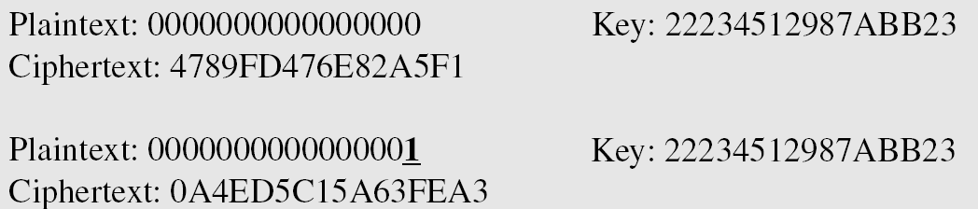
Avalanche effect
To check the avalanche effect in DES, let us encrypt two plaintext blocks (with the same key) that differ only in one bit and observe the differences in the number of bits in each round.

Slide 63
Experiments have found that DES versions with less than 16 rounds are even more vulnerable to known plain text attacks than brute force attack , That justifies the use of 16 rounds
Weaknesses in Cipher Design
  Weaknesses in S-boxes
  Weaknesses in P-boxes
  Weaknesses in Key

Slide 64
Applications of DES
Data Security in Banking
  Secure fund transfers (e.g., ATM transactions, SWIFT network)
  Encrypting PINs and cardholder information
Secure Communication
  Encrypting emails and messages
  Securing VoIP and telecommunication networks
File and Disk Encryption
  Encrypting sensitive files and documents
  Used in early disk encryption tools

Slide 65
Applications of DES
Identity Verification & Authentication
  Used in challenge-response authentication systems
  Biometric data encryption
Smart Cards and Embedded Systems
  Secure authentication in access control systems
  Encrypting stored data on smart cards
Wireless and Network Security
  Used in older VPNs and network security protocols
  Secure key exchanges
Digital Rights Management (DRM)
  Protecting copyrighted digital media
  Encryption in early DVD protection systems

Slide 66
Limitations of DES
1. Small Key Size (56-bit)
  Vulnerability: The 56-bit key is too short by today's standards, making it susceptible to brute-force attacks.
  Example: In 1998, the EFF (Electronic Frontier Foundation) built a machine that cracked DES in under 3 days. Modern systems can do it even faster.
2. Susceptible to Brute-Force Attacks
  DES relies solely on the strength of its key. With advancements in computing power, brute-forcing DES is now feasible for even moderately resourced attackers.
3. Slow Performance in Software
  DES was optimized for hardware, not software.
  In software implementations, especially on general-purpose processors, it performs inefficiently compared to algorithms like AES.
4. Vulnerable to Cryptanalytic Attacks
  Differential and Linear Cryptanalysis: Techniques discovered in the 1990s can analyze DES more effectively than brute force, reducing its effective security.
  Meet-in-the-Middle Attacks: Particularly relevant for DES variants like Double DES.

Slide 67
Limitations of DES
5. Insecure in Certain Modes of Operation
  When used in modes like ECB (Electronic Codebook), patterns in the plaintext can still be visible in the ciphertext, compromising data confidentiality.
6. Lack of Flexibility
  Fixed block size of 64 bits, which is small for modern data encryption needs.
  Key schedule is relatively weak, making the key generation process predictable in some cases.
7. Legacy Dependency
  Despite its weaknesses, some systems still use DES due to legacy constraints, posing security risks if not properly updated or managed.

Slide 68
Advanced Encryption Standard

Slide 69
Introduction to AES
History and Development
Key Features of AES
How AES Works (Encryption Process)
AES Structure (Rounds and Key Sizes)
Modes of Operation
Applications of AES
Advantages of AES
Limitations of AES
AES vs DES Comparison
Conclusion

Slide 70
Introduction to AES
What is AES?
  AES (Advanced Encryption Standard) is a symmetric-key encryption algorithm.
  Used to secure data through encryption and decryption.
Developed by: Vincent Rijmen and Joan Daemen.
Origin: Developed as the successor to DES.
Adopted by: U.S. National Institute of Standards and Technology (NIST) in 2001.
Also known as: Rijndael algorithm (its original name).

Slide 71
Introduction to AES
In February 2001, NIST announced that a draft of the Federal Information Processing Standard (FIPS) was available for public review and comment.
Finally, AES was published as FIPS 197 in the Federal Register in December 2001.

Slide 72
Introduction to AES
AES is a non-Feistel cipher that encrypts and decrypts a data block of 128 bits.
It uses 10, 12, or 14 rounds.
The key size, which can be 128, 192, or 256 bits, depends on the number of rounds

Slide 73
Key Features of AES
Block Cipher – Operates on 128-bit data blocks.
Key Sizes – Supports 128, 192, and 256-bit keys.
Fast & Efficient – Works well in both hardware and software.
Strong Security – Resistant to cryptanalysis attacks.
Widely Used – Found in VPNs, banking, military, and more.

Slide 74
AES Structure (Rounds and Key Sizes)
AES-128: 10 rounds
AES-192: 12 rounds
AES-256: 14 rounds
Each round increases security and complexity.

Slide 75
Round Keys created by the Key expansion algorithm are always 128 bits , the same size as the plaintext or ciphertext
The number of round keys generated by the key expansion algorithm is always one more than the number of rounds
Number of Round Keys=N_{r}+1
Round Keys are K₀,K₁,K₂,……………….K_{Nr}

Slide 76
How AES Works (Encryption Process)
Key Expansion: Generates round keys from the cipher key.
Initial Round: AddRoundKey (XOR with the key).
Main Rounds (9/11/13 Rounds):
  SubBytes (byte substitution using S-box).
  ShiftRows (row-wise shifting).
  MixColumns (column mixing for diffusion).
  AddRoundKey.
Final Round: Same as main rounds but without MixColumns.

Slide 77
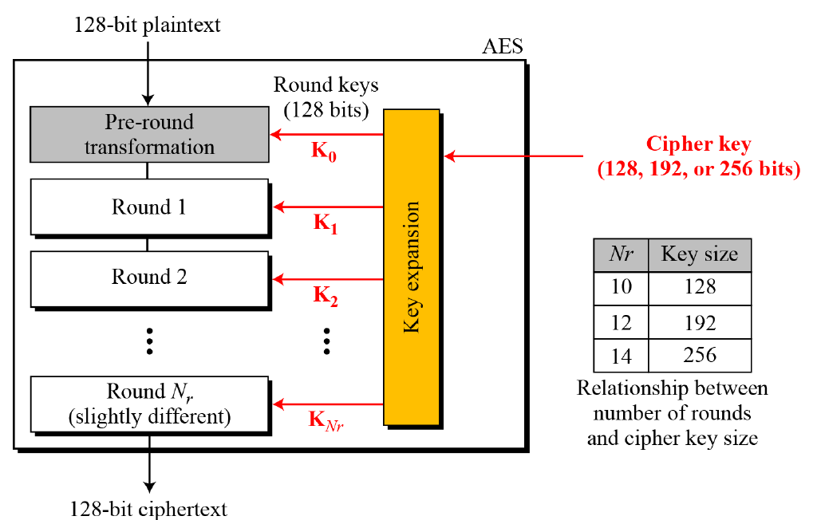
AES: General design structure

Slide 78
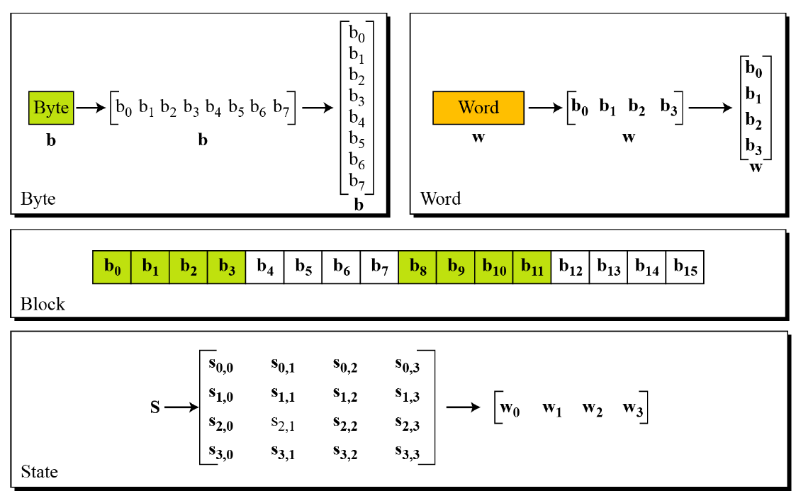
Data sizes in AES
Byte- 8 bits
Word- 32 bits
Block – 128 bits
State- 16 bytes

Slide 79
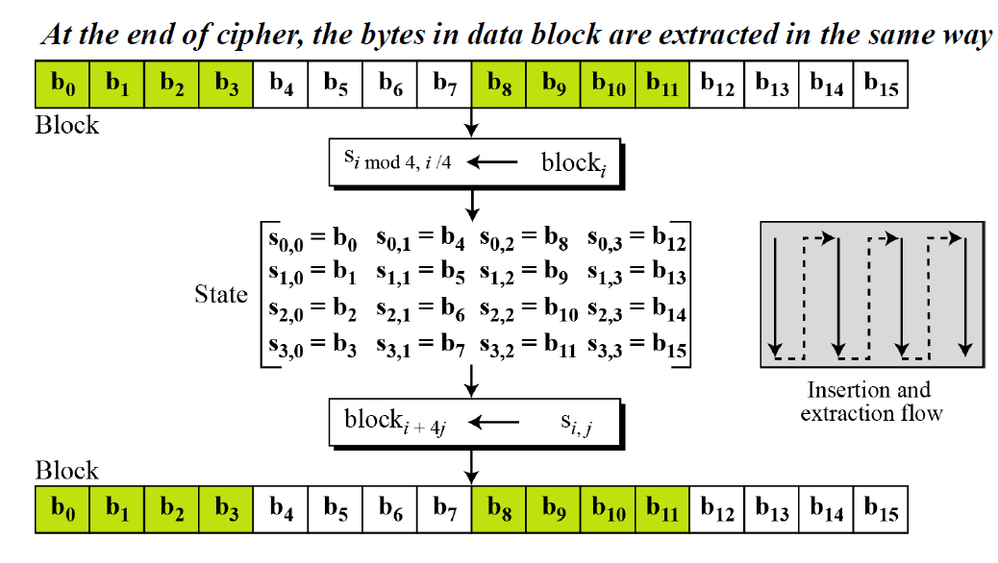
Data transformation - bit, block, state

Slide 80
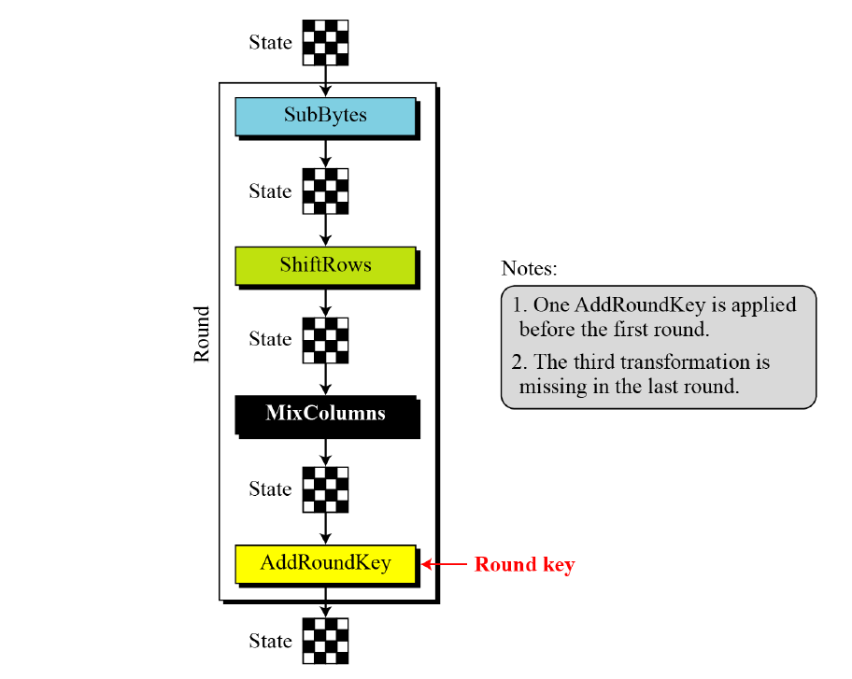
Structure of AES round
All transformations are invertible
The pre-round section uses only one transformation(AddRoundKey)
•In the last round, MixColumns transformation is missing

Slide 81
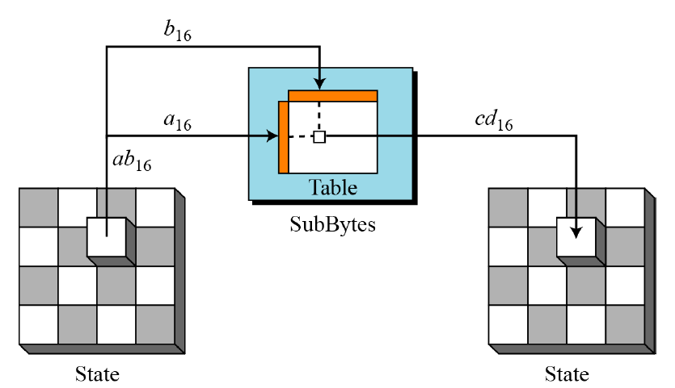
SubBytes- involves 16 independent byte-to-byte transformations
State is treated as 4X4 matrix of bytes
Transformation is done one byte at a time
The content of each byte is changed but the arrangement of the bytes in the matrix remains the same
Each byte is transformed independently

Slide 82
SubBytes
The Substitution Table is used (S Box) for SubBytes transformation
Provides confusion effect
Two bytes 5A₁₆ and 5B₁₆ which differ only in one bit are transformed to BE₁₆ and 39₁₆ which differ in four bits

Slide 83
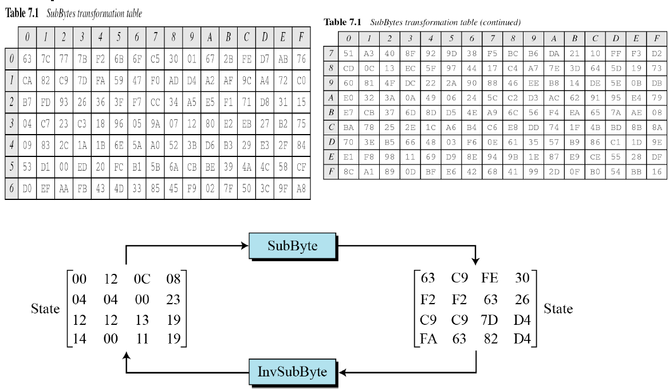

Slide 84
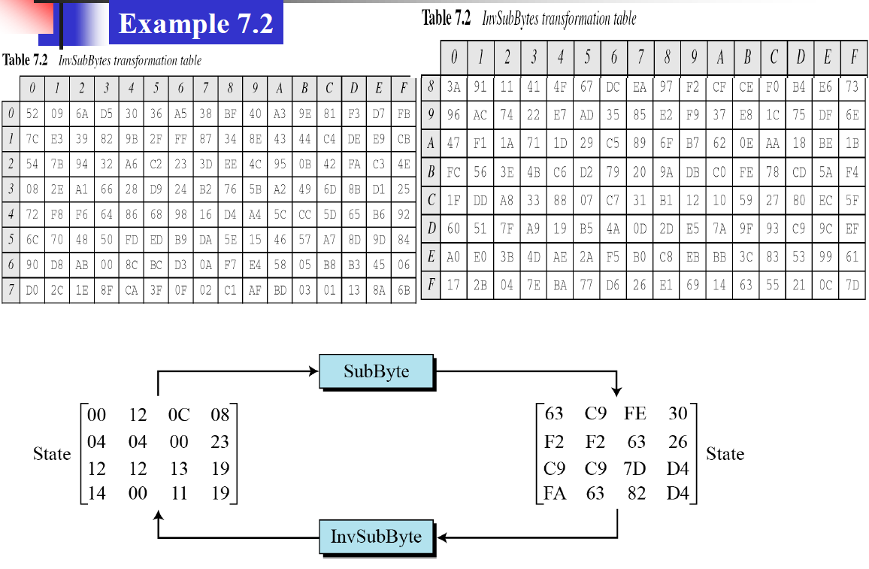
SubBytes and InverseSubBytes

Slide 85
ShiftRows
Another transformation found in a round is shifting, which permutes the bytes.
In DES, Permutation is done at the bit level, Shifting transformation in AES is done at the byte level
The order of the bits in the byte is not changed

Slide 86
ShiftRows
In the encryption, the transformation is called ShiftRows.
Shifting is to the left
The no of shifts depends on the row number(0,1,2,3) of the state matrix
Shift row transformation operates one row at a time

Slide 87
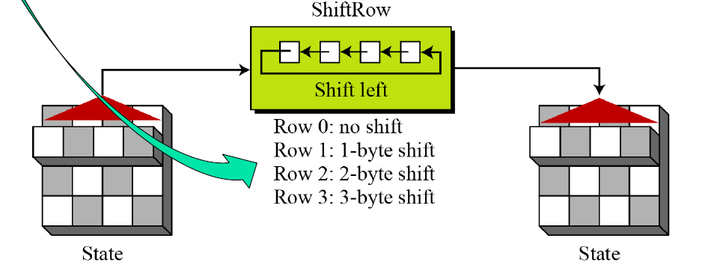
ShiftRows

Slide 88
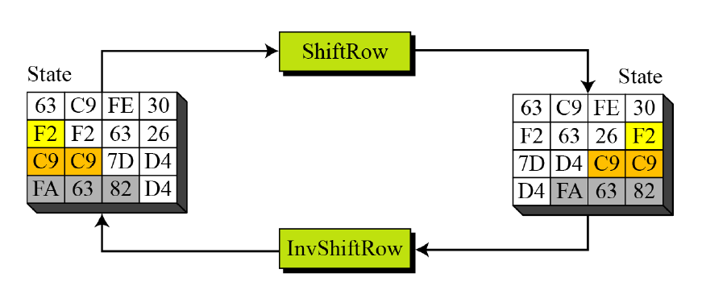
InvShiftRows
the shifting is to the right.
The number of shifts is the same as the row number (0,1,2 and 3) of the state matrix
ShiftRows and InvShiftRows transformations are inverses of each other

Slide 89
Mixing
interbyte transformation that changes the bits inside a byte, based on the bits inside the neighboring bytes.
Takes 4 bytes at a time, combining them to recreate four new bytes
Each new byte is different, even if all 4 bytes are the same
Multiplies each byte with a different constant and mixes them

Slide 90
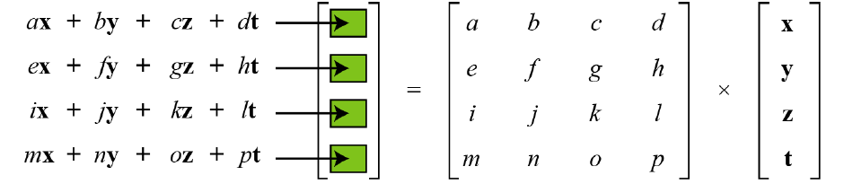
Mixing

Slide 91
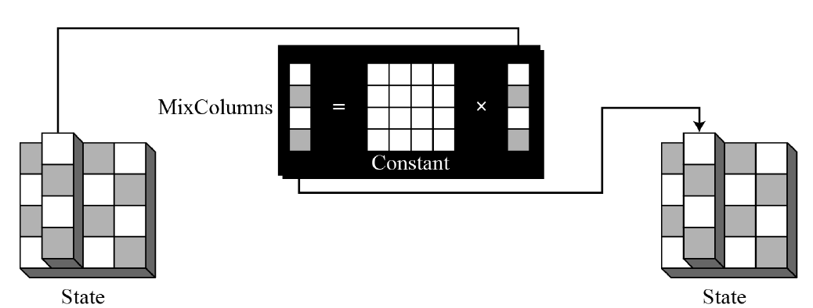
MixColumns & Inv MixColumns
The MixColumns transformation operates at the column level; it transforms each column of the state to a new column.
Matrix multiplication of a state column by a constant square matrix
The InvMixColumns transformation is basically the same as the MixColumns transformation

Slide 92
AddRoundKey
Each Round key is 128 bits long
Treated as Four 32 bit words
For adding the key to the state , each word is considered as a column matrix
AddRoundKey proceeds one column at a time.
AddRoundKey adds a round key word with each state column matrix;
The operation in AddRoundKey is matrix addition.
The AddRoundKey transformation is the inverse of itself.

Slide 93
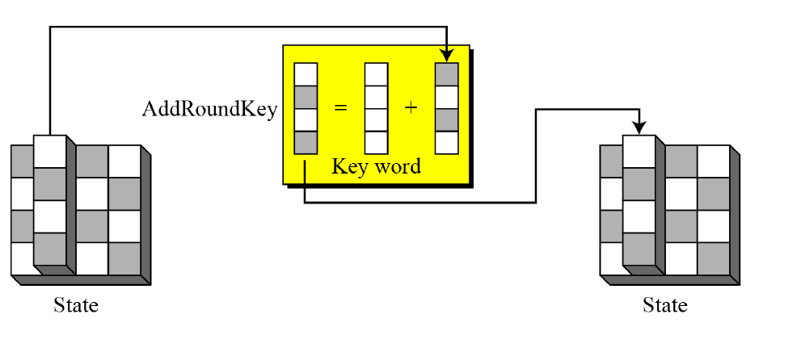
AddRoundKey

Slide 94
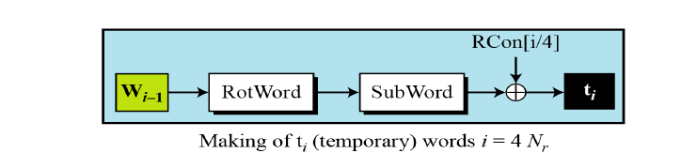
Key expansion
RotWord-
  Rotate Word
  Takes a word as an array of 4 bytes
  Shifts each byte to the left with wrapping
SubWord-
  Substitute Word
  Takes each byte in the word and substitute another byte for it
Round Constants- (Generated with some mathematical logic)
  Rcon=4 byte value, Rightmost three bytes are always Zero

Slide 95
Each round key in AES depends on the previous round key.
The dependency, however, is nonlinear because of SubWord transformation.
The addition of the round constants also guarantees that each round key will be different from the previous one.

Slide 96
Key expansion analysis
designed to provide several features that thwart the cryptanalyst.
Two different Cipher keys, no matter how similar to each other, produce two expansions that differ in atleast a few rounds
Each bit of cipher key is diffused into several rounds.
Changing a single bit in the cipher key, will change some bits in several rounds
No serious weak keys in AES

Slide 97
AES Decryption
🔄 Reverse process of encryption:
Uses :
  Inverse SubBytes,
  Inverse ShiftRows, and
  Inverse MixColumns.
The AddRoundKey step remains the same.

Slide 98

AES process

Slide 99
Why AES is Secure?
Large Key Size – 128-bit key has 2¹²⁸ possible keys.
Strong S-box – Prevents linear and differential cryptanalysis.
No Known Practical Attacks – Even brute-force attacks are infeasible.
Used by Governments & Organizations – Approved for Top Secret U.S. data.

Slide 100
Applications of AES
🔐 Cybersecurity – Secure communication, SSL/TLS encryption.
🏦 Banking & Finance – Secure transactions and ATM encryption.
📱 Mobile Security – Used in encrypted messaging apps like WhatsApp.
🔑 Disk & File Encryption – BitLocker, VeraCrypt, and other encryption tools.
🛰 Government & Military – Protection of classified information.

Slide 101
Advantages of AES
High Security: Resistant to known cryptographic attacks.
Speed: Efficient in both hardware and software.
Flexibility: Supports various key lengths.
Global Standard: Widely adopted across industries.

Slide 102
Limitations of AES
Key Management Challenges: Security relies heavily on key secrecy.
Vulnerability in Poor Implementations: Side-channel attacks if not properly implemented.
Not Suitable for Very Large Data Streams in its basic form without modes like CTR.

Slide 103
Thank you!!

